Slide 1
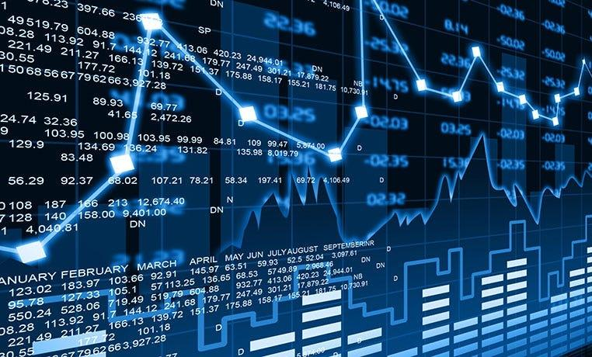
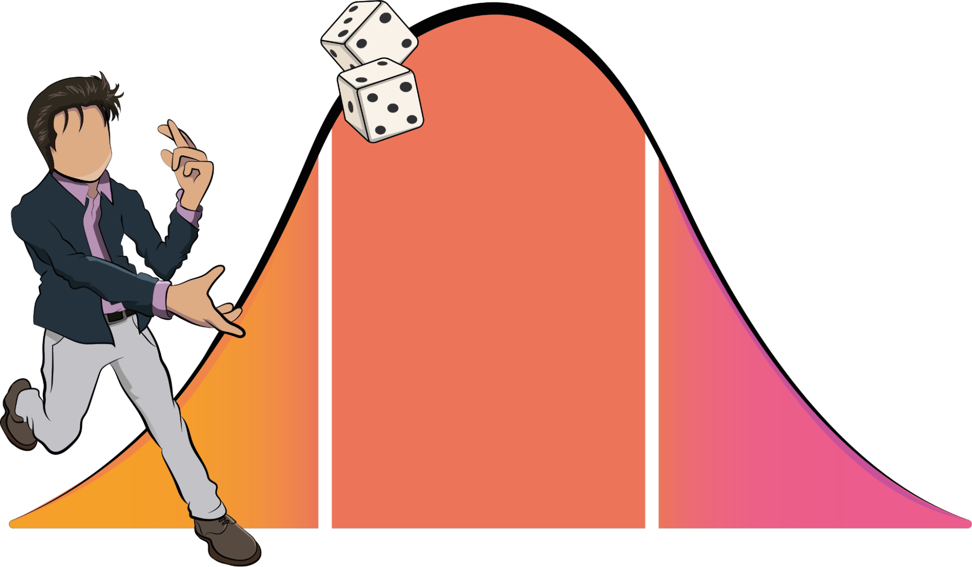
MONTE CARLO STOCK PRICE ANALYSIS

Slide 2

Problem statement
Introduction
Stock Market Review
Monte Carlo Simulation
Conclusion
Recommendations

Slide 3

Can we use the Monte Carlo Simulation to forecast future stock Market Prices to Invest In?

Slide 4

Monte Carlo Method
Mathematical technique to solve problems through random sampling.
Predicts the probability of different outcomes from potentially random variables
Procter & Gamble
Mastercard Inc
Bitcoin
Stock Market

Slide 5

STOCK MARKET REVIEW

Slide 6
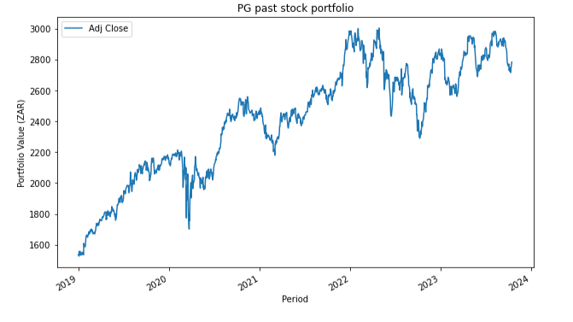
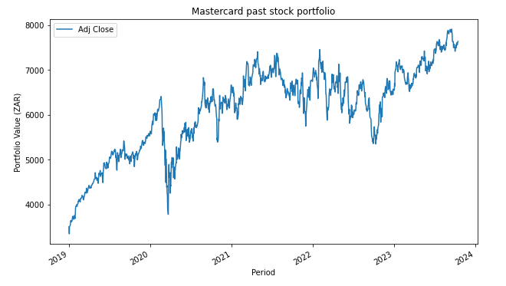
PG and MASTERCARD
Shows how the closing price differs from day on day.
Both have been increasing since 2019.
There was a drop in the first half of 2020.

Slide 7
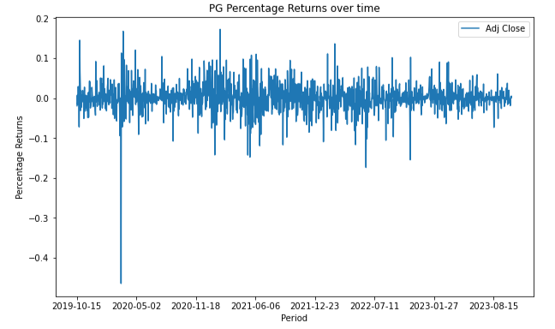
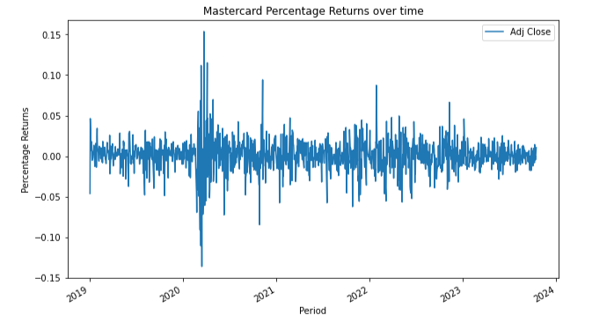
PG and MASTERCARD
Static Percentage change across time.
drastic difference in the first half of 2020.

Slide 8
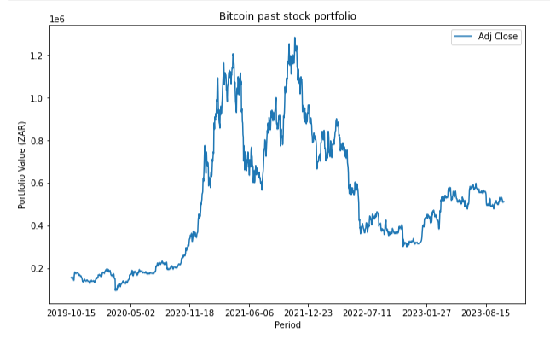
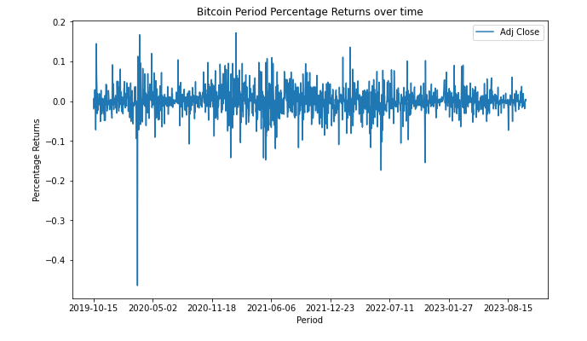
Bitcoin
Shows how the closing price differs from day on day.
Even though the stock price dropped from 2022, but Bitcoin prices has grown compared to ZAR.

Slide 9
MONTE CARLO SIMULATION

Slide 10
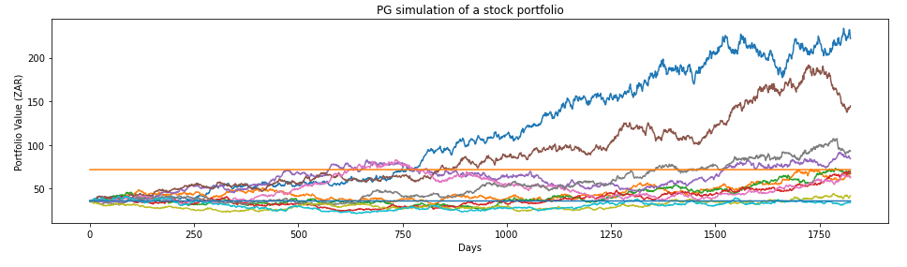
PG Simulation For the next 5 years
Simulation is done in days’ interval. This is the next 5 years.
Blue line is our initial portfolio.
Orange line is double our starting portfolio.
There’s less probability for our portfolio to lose value.
There’s still probability that our portfolio can quadruple in value.

Slide 11
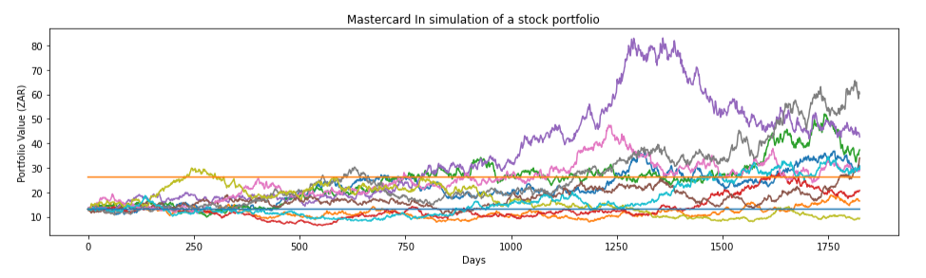
Mastercard Simulation For the next 5 years
Simulation is done in days’ interval. This is the next 5 years.
Blue line is our initial portfolio.
Orange line is double our starting portfolio.
There’s less probability for our portfolio to lose value.

Slide 12
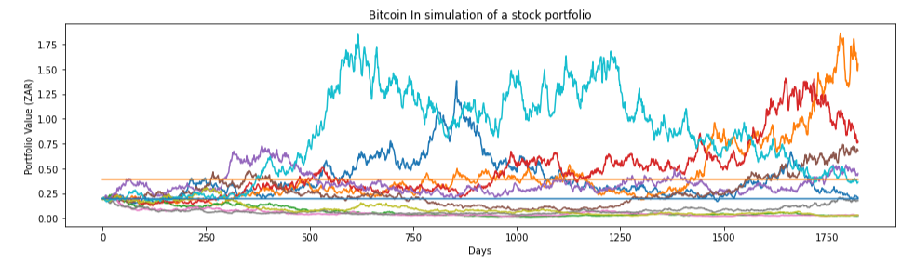
Bitcoin Simulation For the next 5 years
Simulation is done in days’ interval. This is the next 5 years.
Blue line is our initial portfolio.
Orange line is double our starting portfolio.
There high probability for our portfolio may stay stable in value.
There’s also probability that our portfolio may gain value. It is risky though.

Slide 13
Conclusion
From our results we saw that:
There is a probability if we invest in PG, we can double our value, but less probability to lose value.
There is a probability if we invest in Mastercard, we can double our value, but it’s value is less than that of PG.
There’s high probability that we may not see any increase in our investment in Bitcoin.
In conclusion, it’s best to invest in PG. It looks promising for the next 5 years. We can then reconsider after 5 years.

Slide 14
Recommendations
As the number of Monte Carlo simulations increases, so does the convergence to the ‘exact’ solution. It is then recommended to run more simulations .
Sensitivity Analysis can help identify which parameters are sensitive to our data set.
Seek expert advice in economics and stock market.

Slide 15

Thank You

